Slide 1
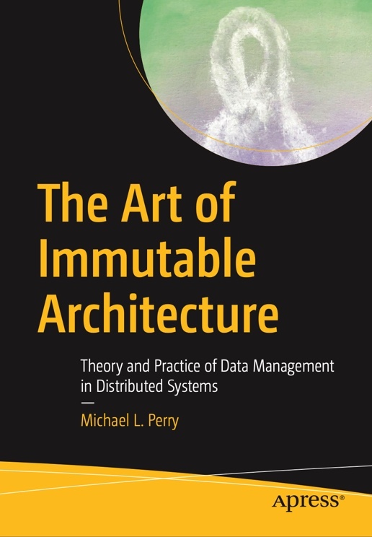
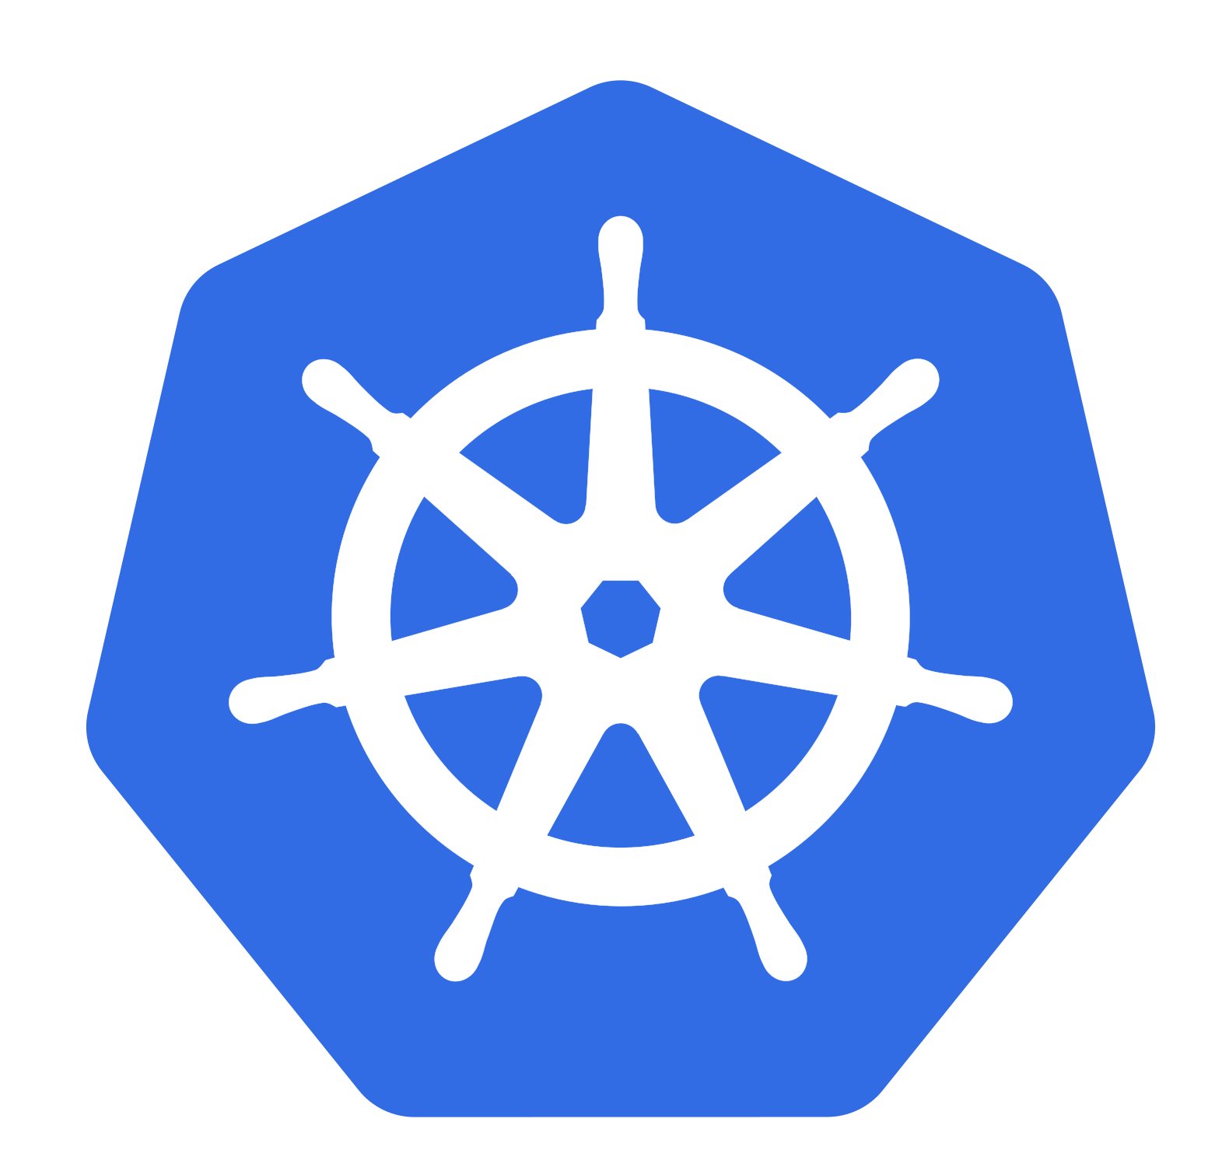
Kubernetes. Now What?
Data Management in a Distributed Cluster
Michael L Perry
@michaellperry
The Art of Immutable Architecture
ImmutableArchitecture.com

Slide 2
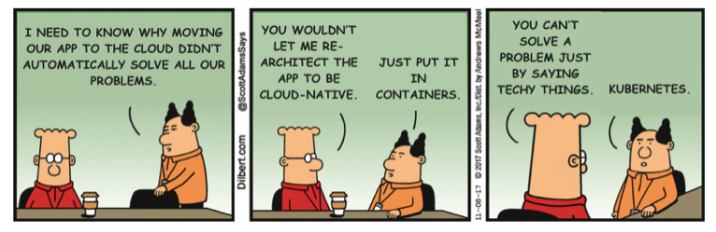
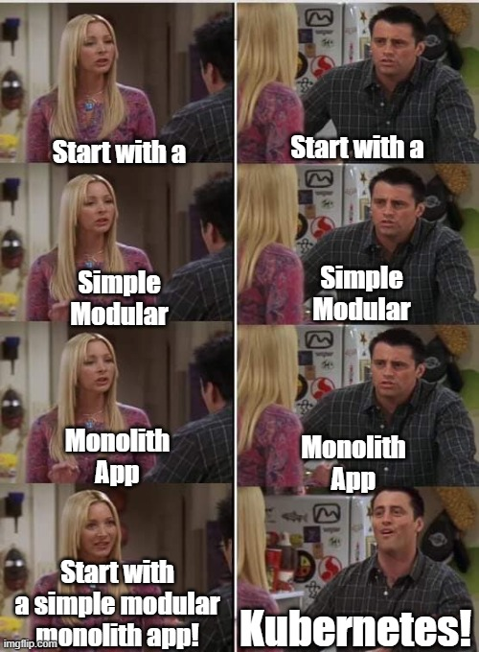
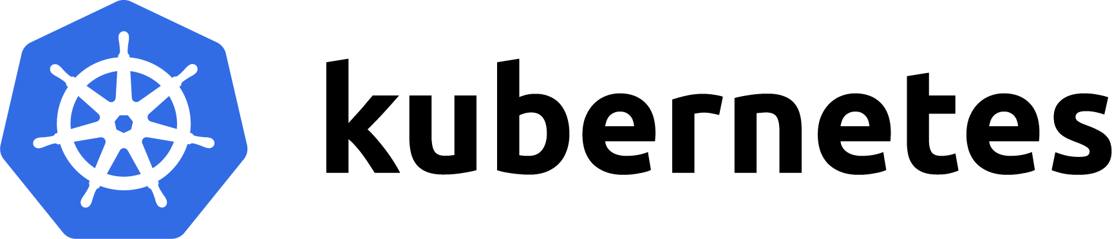
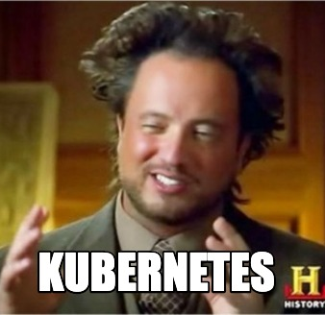
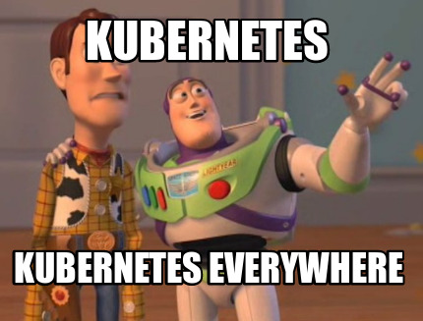
Notes:
Kubernetes has become a punchline.
The theme of the joke is that developers reach for this tool as a solution to all of their problems.
Once they have Kubernetes, there's nothing more that they need.
There is some truth to this joke.
It's a challenge to manage topology.
Kubernetes addresses these challenges.

Slide 3
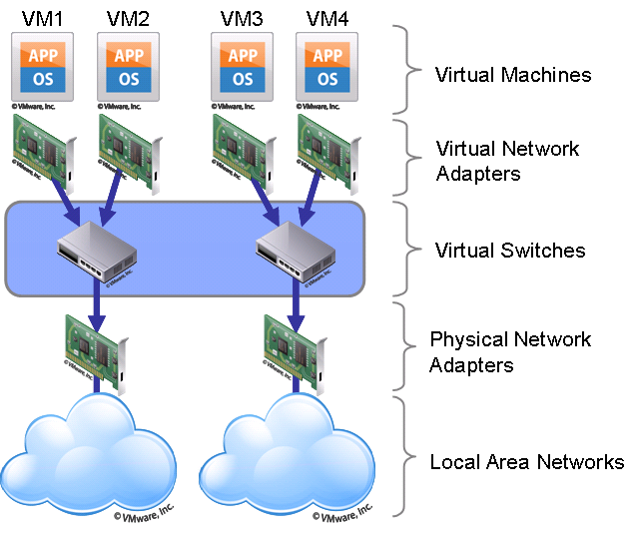
inmon.com
Notes:
Before Kubernetes, before Docker even, the tool that developers reached for in order to manage topology was virtual machines.
A virtual machine was an investment.
It had to be maintained, patched, and cared for.
Their networks had to be configured by hand, every virtual NIC mapped to the host machine, and every route coded into IP and domain lookup tables.

Slide 4
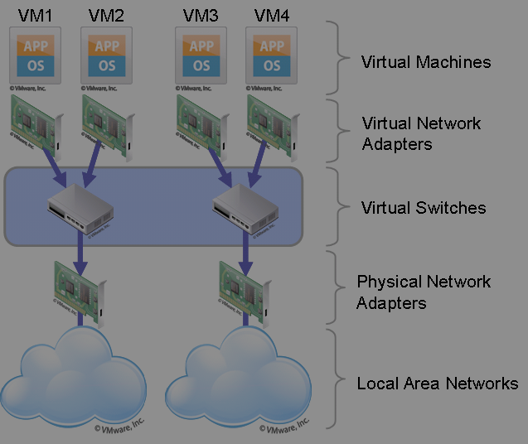
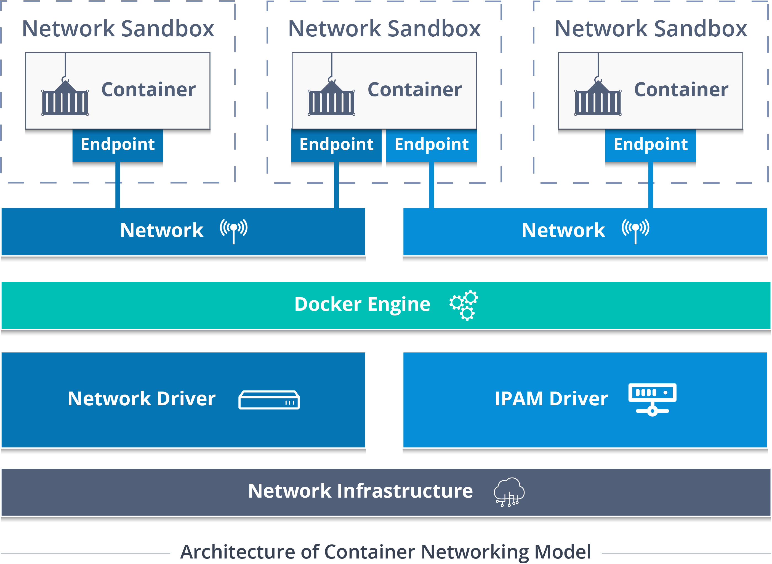
edur
edur
edureka.co
Notes:
Then along game Docker.
A container is not an investment.
It's transient.
It is destroyed rather than changed, and a new one is put in its place.
As containers come and go, they configure their own routes, map their own NICs.

Slide 5
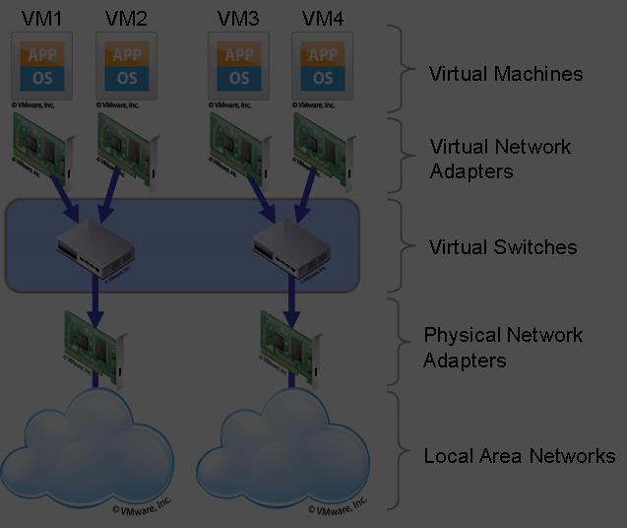
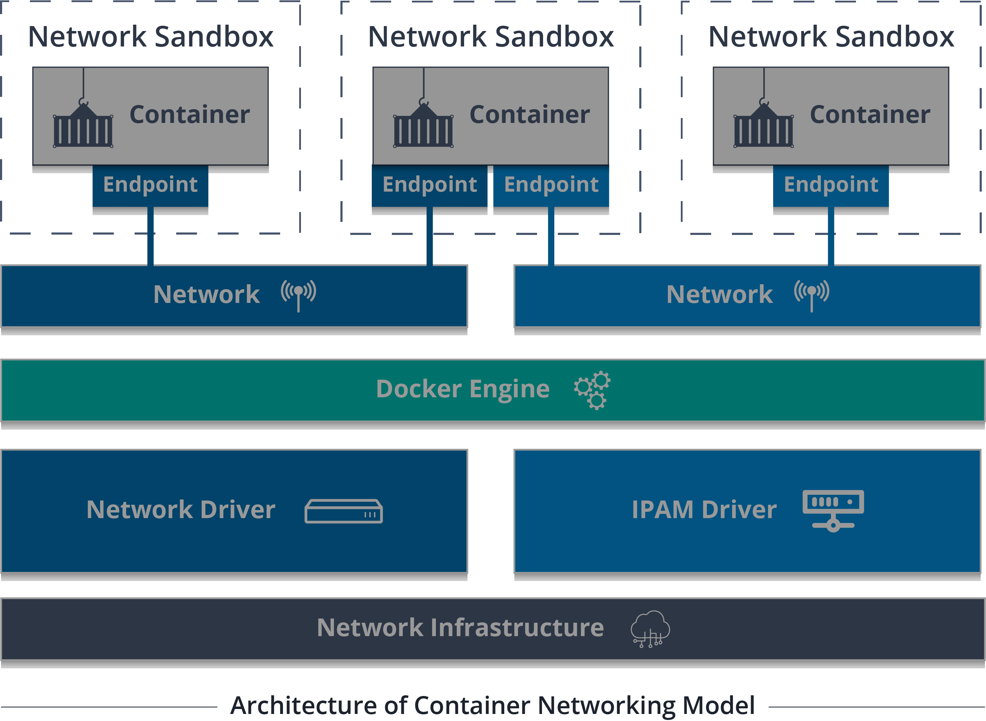
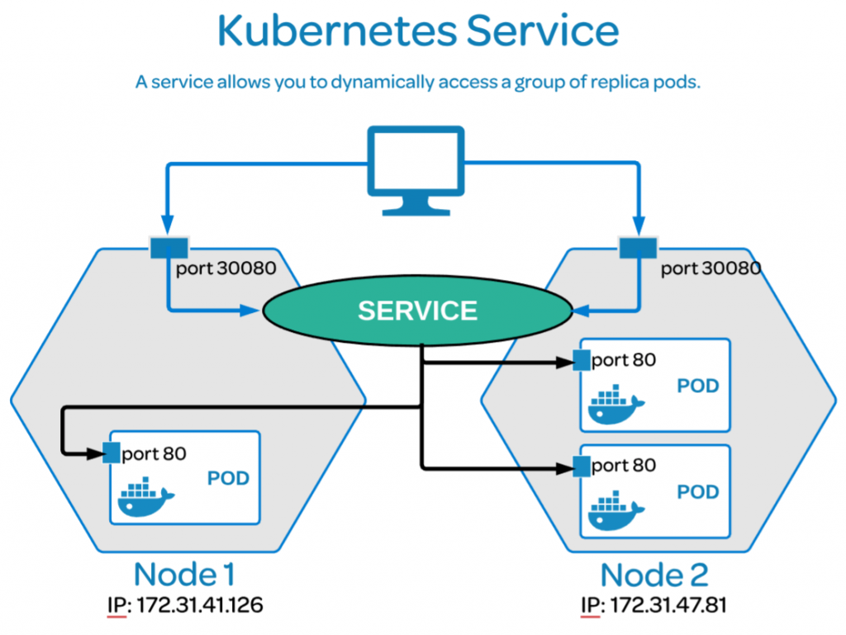
edur
edur
edureka.co
cloudstackgroup.com
Notes:
It looked like the burden was just going to shift from managing VMs to managing containers.
Then quickly on the heels of Docker along came Kubernetes.
Services are mapped to containers simply by name.
The private network is separated from the public network with a single declaration.
Containers are added to and removed from load balancers as they are deployed and destroyed.
Topology management has been solved.

Slide 6
Topology
Consistency
Notes:
When you solve one hard problem, another hard problem rises up to take its place.
Kubernetes solved the topology problem.
But we still have a consistency problem.

Slide 7
Pod
Notes:
Let’s take a closer look at your Kubernetes cluster.
It has a container, which is running an image.

Slide 8
Service
Deployment
Notes:
You need to scale it up, so you create multiple pods.
This is a deployment.
Each pod is running the same containers crated from the same images.
And to access that workload, you have a service.
The service load-balances across all of the pods in the deployment.
When a request hits the front end, it doesn’t matter which pod it ends up at.
This workload is stateless.
All pods act the same way.

Slide 9
Stateful Set
Notes:
But some workloads are not stateless.
These pods need to store data.
So you mount a volume to each pod.
Now this is a stateful set.
When a request comes into this service, we have a consistency issue.
Each pod has a different volume, so it will matter which one the service routes to.
If a request is routed to the first pod, it might store an object in the first volume.
Now you want that object to be replicated to all of the other volumes so that a subsequent request can go to any of the other pods.
If you have a clustered workload like Postgres or Elasticsearch, it can do that replication for you.

Slide 10
Stateful Set
Notes:
It will use another port, which you map to another service, to replicate state among the pods.
It can do this because all of the pods are running the same workload.
They are all hosting containers running the same images.
All of those objects are going to be in exactly the same format.
Let’s keep looking at your Kubernetes cluster.

Slide 11
Web Cluster
Database Cluster
Notes:
You have some stateless deployments, like your web cluster.
And some stateful sets like your database cluster.
Your web cluster is consistent because it’s stateless.
And your database cluster is consistent because it knows how to replicate.

Slide 12
Web Cluster
Database Cluster
Search Cluster
Notes:
Then you add a new stateful set.
This one is a search cluster.
And now you have a consistency problem that Kubernetes can’t help you solve.

Slide 13
Notes:
The application stores objects in the database cluster.
The cluster knows how to replicate them within the stateful set.

Slide 14
Notes:
But you also want those same objects indexed in the search cluster.
You want your users to be able to search the information that’s in the database.
The search index needs to be consistent with the database.

Slide 15
Notes:
Even though these are logically the same objects, they are different formats.
The database volumes contain tables, and the search volumes contain indexes.
It’s up to your application to translate between these two formats.

Slide 16
Notes:
And when your application stores a new object in the database, you want it to appear in the index.
What solutions do we have for this problem?

Slide 17
Notes:
We have service busses, message queues, event stores.
Things that will help us to carry objects from one format in one volume, and write it in a different format on a different volume.

Slide 18
Notes:
We have service busses, message queues, event stores.
Things that will help us to carry objects from one format in one volume, and write it in a different format on a different volume.

Slide 19
Notes:
We have service busses, message queues, event stores.
Things that will help us to carry objects from one format in one volume, and write it in a different format on a different volume.

Slide 20
Notes:
We have service busses, message queues, event stores.
Things that will help us to carry objects from one format in one volume, and write it in a different format on a different volume.
You can run all of these things in Kubernetes.
But you have to build them into your application yourself.
You are responsible for solving the consistency problem.

Slide 21
Different Branches
Rebase local events onto remote events
Working branch 2
Working branch 1
Main branch
Working branch 3

Slide 22
Different Branches
Rebase local events onto remote events
Working branch 2
Working branch 1
Main branch
Working branch 3

Slide 23
Different Branches
Rebase local events onto remote events
Working branch 2
Working branch 1
Main branch
Working branch 3

Slide 24
Different Branches
Rebase local events onto remote events
Working branch 2
Working branch 1
Main branch
Working branch 3

Slide 25
Different Branches
Rebase local events onto remote events
Working branch 2
Working branch 1
Main branch
Working branch 3

Slide 26
Identify When Order Matters
Draw an arrow to the predecessor

Slide 27
Identify When Order Matters
Draw an arrow to the predecessor

Slide 28
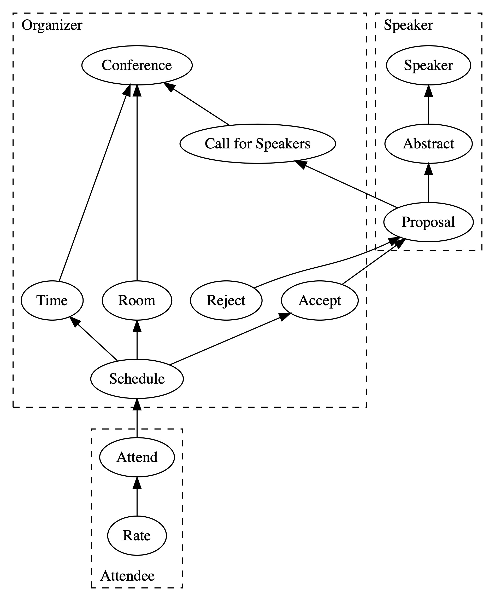
Historical Model
Directed Acyclic Graph (DAG) of historical facts

Slide 29
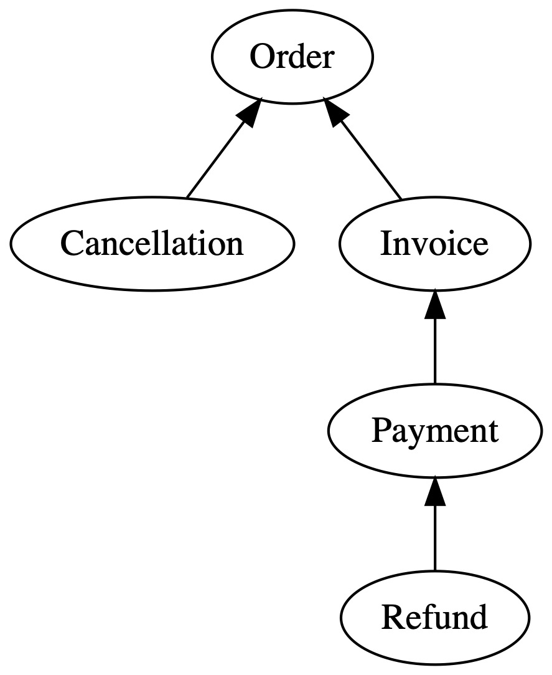
Stages in a Workflow
Capture the relationships between immutable documents

Slide 30
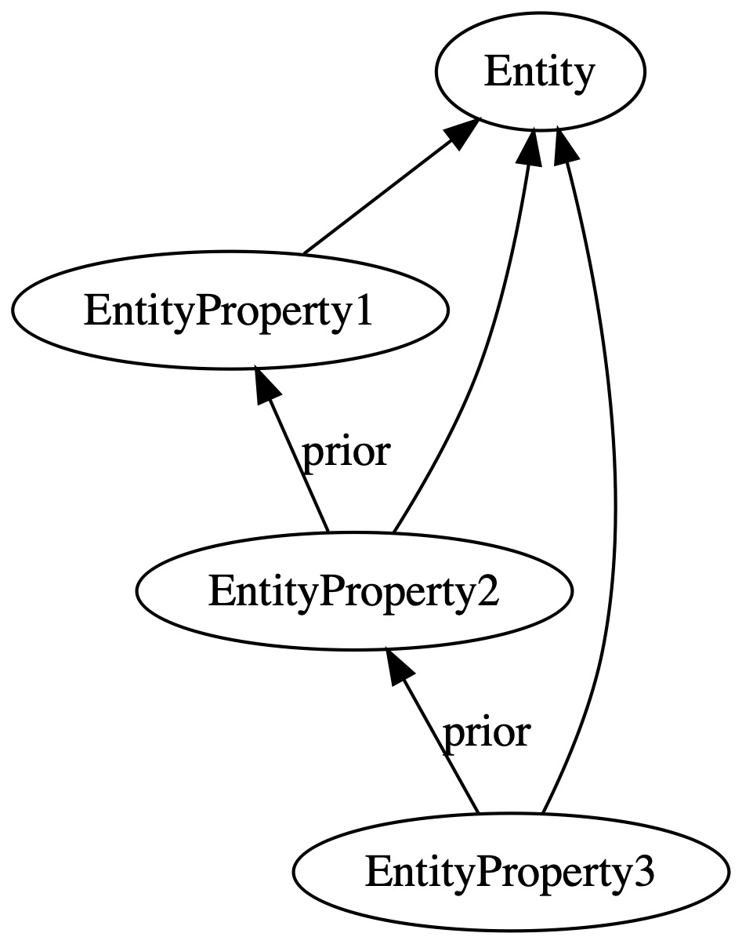
Mutable Properties
Simulate state changes using immutable records
Sequential Edits

Slide 31
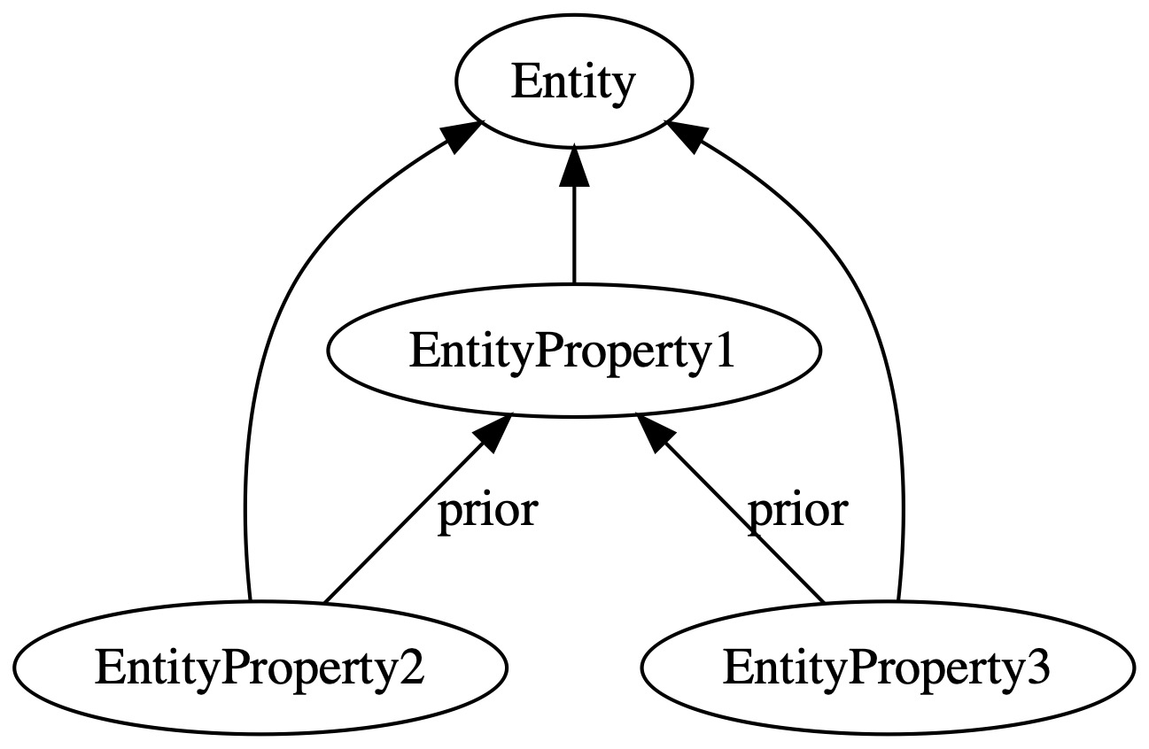
Mutable Properties
Simulate state changes using immutable records
Sequential Edits
Concurrent Edits
Notes:
What do you notice about the second graph?

Slide 32
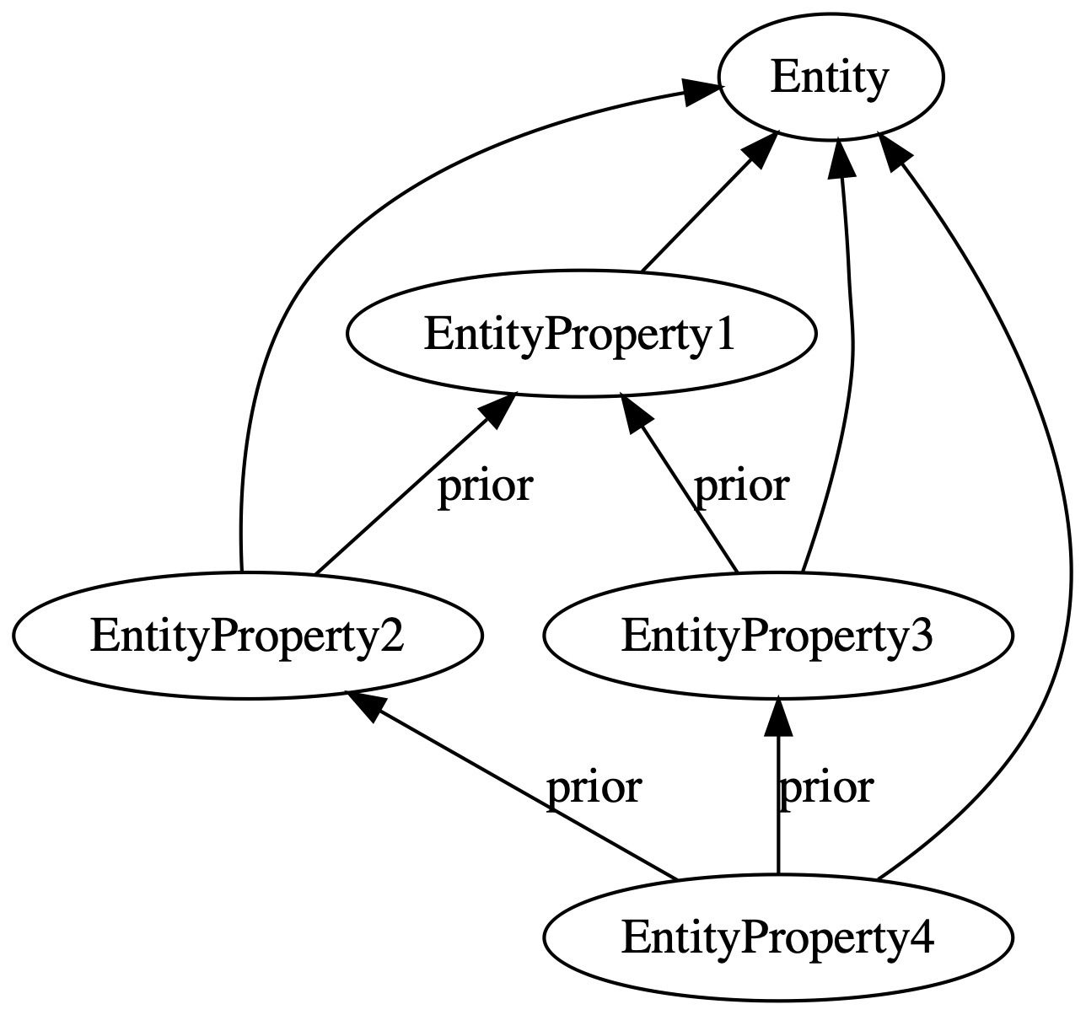
Mutable Properties
Simulate state changes using immutable records
Concurrent Edits
Conflict Resolution
Notes:
What version control operation does this remind you of?

Slide 33
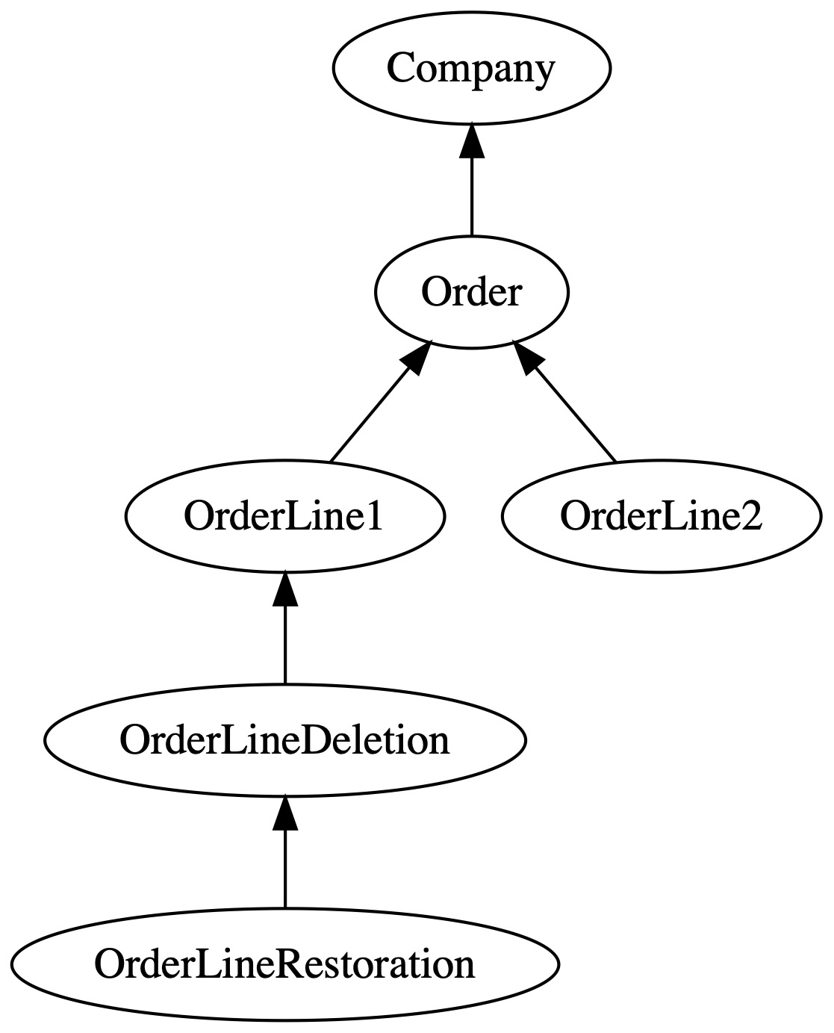
Deletion
Because immutable documents cannot be destroyed

Slide 34
Restoration
Because people make mistakes

Slide 35
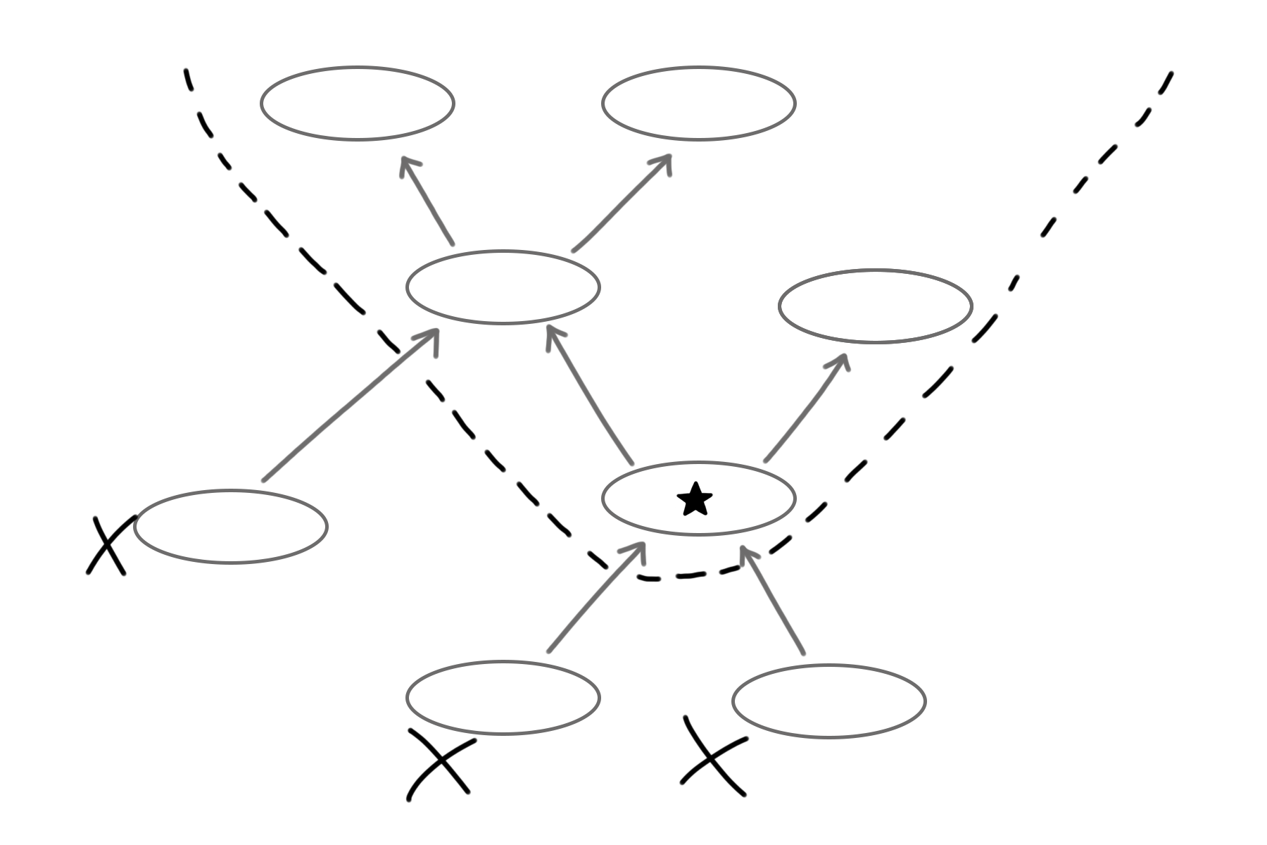
Message Design
Compute the transitive closure of facts

Slide 36
Database Cluster
Search Cluster

Slide 37
Database Cluster
Search Cluster

Slide 38
Topology
Consistency

Slide 39
Kubernetes. Now What?
Data Management in a Distributed Cluster
Michael L Perry
@michaellperry
The Art of Immutable Architecture
ImmutableArchitecture.com

